Slide 1
Food Insecurity
Liana Principe
Notes:
-Hello, my name is Liana and the topic of my research focuses on food insecurity.
-Food insecurity is defined as the condition of not having access to sufficient amount or quality of food to meet one's basic needs, which brings us to the problem where

Slide 2
The Problem
According to the USDA, more than 34 million people in the United States experience food insecurity
9 million children, in the United States are food insecure
Equates to ~10% of the United States population
Notes:
According to the USDA, 34 million people in the US experience food insecurity.
Of that 34, 9 million of them are children
And that in total equates to ~10% of the US population
https://www.npr.org/2023/03/17/1163131918/snap-benefits-food-hunger-pandemic-assistance
https://www.census.gov/library/stories/2021/02/demographic-snapshot-not-everyone-eligible-for-food-assistance-program-receives-benefits.html
‘The boosted benefits expired this month and payments are dropping by about $90 a month on average for individuals, and $250 or more for some families, according to an analysis by the Center on Budget and Policy Priorities, a nonpartisan research institute.’
The reduction comes as food prices in the U.S. continue to rise. Without the extra help, many people will go hungry.
Food banks aren't a great option for Lisa Clenott, either. "I would say 90% of it, we can't eat," she said.

Slide 3
The Situation
SNAP (formerly Food Stamps) helps on average more than 41 million Americans afford a nutritionally adequate diet each month
However, recent reports estimates that ~ 1/6 of those who are eligible, do not participate in the program.
Notes:
A prominent organization that combats food insecurity is SNAP, formerly known as food stamps, which is an anti-hunger program that helps on average more than 41 million Americans afford a nutritionally adequate diet each month
However, recent studies show that ~1/6 of those who are eligible to redeem SNAP benefits, do not end up utilizing them.

Slide 4
The Research
Use machine learning to identify which features are most impactful in determining if a household will or will not utilize SNAP resources
Notes:
Which ties into the purpose of my research. Use maching learning to identify which features are most impactful in determining if a household will or will not utilize SNAP resources
There have been several studies focused on eligibility as a target variable, but a robust governmental system such as SNAP already has a requirement system and model set in place.
So rather than recreating an already existing model, my research deviates slightly by creating a model that will classify whether households actually utilize the resources

Slide 5
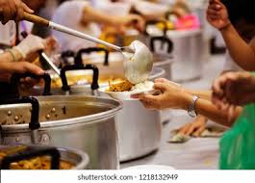
Data Collection
National Household Food Acquisition and Purchase Survey (FoodAPS)
Economic Research Service (ERS) & Food and Nutrition Service (FNS)
April 2012 – January 2013
Comprehensive survey covering the factors that influence household food choices
Household Characteristics
Quantities and Expenditures of purchases
Eating patterns
Food Accessibility
Grocery Store Distance
Diet & Nutrition Knowledge
Notes:
The data used for this study is a study called FoodAPS, which was a comprehensive survey conducted by the ERS and FNS in 2012. The survey asked questions to American households about factors that influence their food choices.
So factors like….

Slide 6
Model Evaluation
RECALL
Out of all SNAP households in the data, how many did the model identify
ROC AUC
How efficient the model is in classifying between target and
non-target variables
Notes:
When designing my models, I would evaluate or measure my model success by a few metrics. The most prominent one was recall, which will tell me how accurate my model is at predicting the target households.
In other words, out of all the SNAP households in the data, how many was my model able to identify.
In this case, recall was my main KPI and I didn’t mind if we overestimated

Slide 7




Optimized Models and Results
Feature Selection/Engineering
Create models
Optimized Parameters
Altered Thresholds
Support Vector Machine
Logistic Regression
XGBoost
Linear Model
Linear Model
Non-Linear Model
~60% Recall
~70% Precision
~73% Accuracy
84% Recall
87% AUC
76% Accuracy
82% Recall
88% AUC
79% Accuracy
Notes:
In terms of the actual models, I focused on 3 classifier models: Support Vector Machine, Logistic Regression, and a Boosted Random Forest.
There was a lot more backend work than just this slide, but essentially I had
Performed feature selection and engineering
created some models
found the most optimized parameters with gridsearch hypertuning
Threshold to enhance the performance metrics you saw on the previous slide in model evaluation
And below are some of the average results from the model building process.

Slide 8
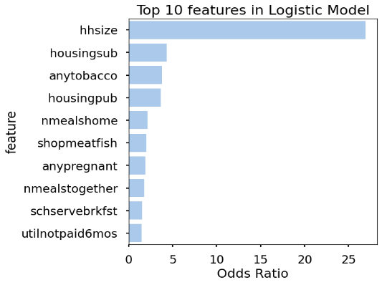
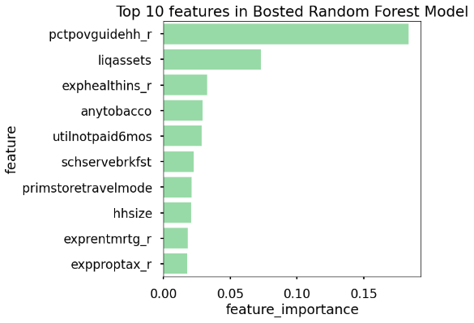
Feature Importance
Top 10 features in Logistic Model
Top 10 features in XGBoost Model
Household size
Income to Poverty Guideline Ratio
Subsidized rent
Liquid Assets
Smokes Tobacco
Health Insurance Expenses
Public Housing
Smokes Tobacco
Meals at Home
Utility not paid in 6mo
Shops at fish market
School serves breakfast
Pregnant
Primary Store Transportation
Meals Together
Household size
School serves breakfast
Mortgage Expenses
Utility not paid in 6mo
Property Tax Expenses
(%)
Notes:
Continuing on, the initial goal of my research was to identify the features or variables that were most impactful on classifying if a household would utilize SNAP benefits or not
So here are the variables that were most impactful to the respective model
Logsitc is on the left and Boosted Random Forest is on the Right
We can see that there is a little bit of overlap, for example, Household Size, Smokes Tobacco, school serves breakfast
Generally speaking, several of the variables defined as most significant in the models are related to topics like expenses, finance, and food aquisition behavior
Top 10 features in XGBoost Model

Slide 9

Next Steps
Forecasting and Prediction
Community Outreach Programs
Informational Campaigns of Available Resources
Food insecurity alleviation branch set-up
Assist Policy Implementation
Notes:
Next Steps:
So now that I have this information, what am I going to do with this
The clearest usecase would be with forecasting, taking the model and the variables and using that to predict households or regions that are more likely to use SNAP resources
Then from there’s a few options depending on scale
It could promote certain local community outreach programs, informational awareness campaigns of available resources, or spark interest in setting up new branches of food insecurity alleviation
On a larger scale, this information can be beneficial for policy programs and decision making
Another future step is, because this study was conducted in 2012, to take inflation data as a factor and apply that to the financial information from the survey and see if that has any affect on the results in the classification model
Which connects to my last point about researching more about local food redistribution sights and what the effects of their contribution might look like
Next Steps in terms of continued research:
Continued model exploration
Deeper understanding of the variables and the individual relationships they have with my research
Better forecasting and prediction models

Slide 10
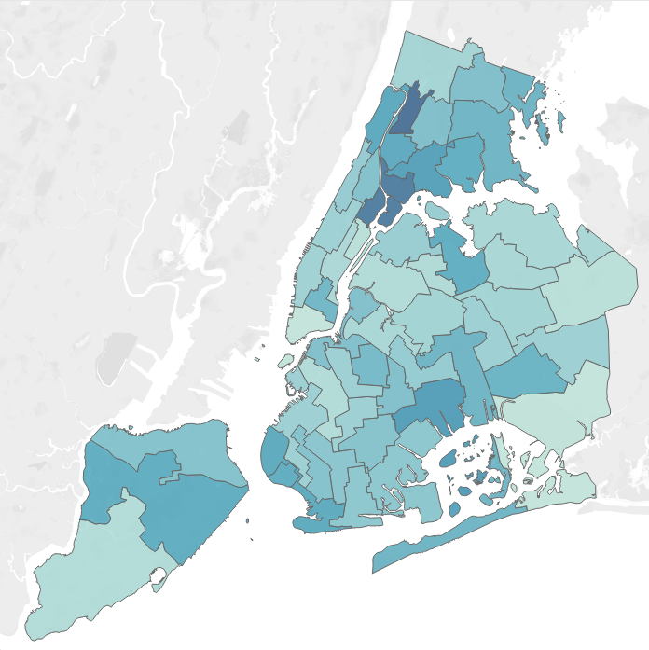
Notes:
For example, this map would be generated from running my model, and can give insight as to how many people in each community district in NYC are utilizing SNAP benefits.
And from this density map, I would say tha this area specifically yin the Bronx has the highest utilization, meaning we would want
higher inventory,
More programs
More volunteers
Or maybe even more food redistribution centers centered around this area.

Slide 11



About Me
Liana Principe
Bachelors in Statistical Mathematics
3+ years experience in Data Analytics
Currently Volunteering with food redistribution at NY Cares
LinkedIn: linkedin.com/in/liana-principe/
GitHub: github.com/lap309/
Notes:
And that is my project, thank you! If you have any questions, insights, or want to help in my project my contact information is on the board

